Slide 1
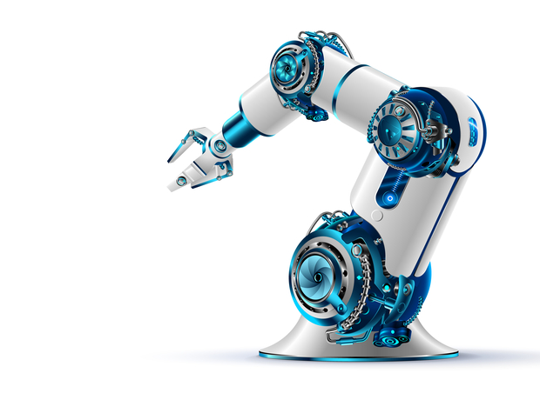
INTELLIGENT VOICE ASSISTED ROBOTIC ARM
PROJECT AED415
Presented by,
Anjali H Nair(CHN19E008)
Mohammed Shaheer V K(CHN19AE015)
Anagha P (LCHN19AE021)
Arathy C S(LCHN19AE022)
Guided by,
Sylish S V,
Asst Professor
Dept of Electronics
DEPT OF ELECTRONICS
COLLEGE OF ENGINEERING ,CHENGANNUR

Slide 2
Intelligent Voice Assisted Robotic Arm
Innovative system combining voice commands, machine learning, and robotics for industrial operations.
Integration of PyTorch, YOLOv5 algorithm, and SCORBOT-ER 4u robotic arm for efficient task execution.
Unveiling the potential of our intelligent voice-assisted robotic arm in automation and complex tasks

Slide 3
PROBLEM STATEMENT
Need for an advanced system integrating voice commands, machine learning, and robotics.
System should streamline shape recognition and enable precise pick-and-place operations.
There is a need to enhance tabletop operations to empower differently-abled individuals and parallelized people with greater independence and self-reliance.

Slide 4
PROJECT OBJECTIVES
Contribute to the advancement of automation and robotics technology, paving the way for future innovations in the field.
Develop an intelligent voice-assisted robotic arm system capable of recognizing and manipulating objects based on their shape.
Integrate the SCORBOT-ER 4u robotic arm for precise pick-and-place operations based on the identified object's coordinates.

Slide 5
METHADOLOGY
MACHINE LEARNING
SCORBOT
EXECUTION
VB SCRIPT

Slide 6
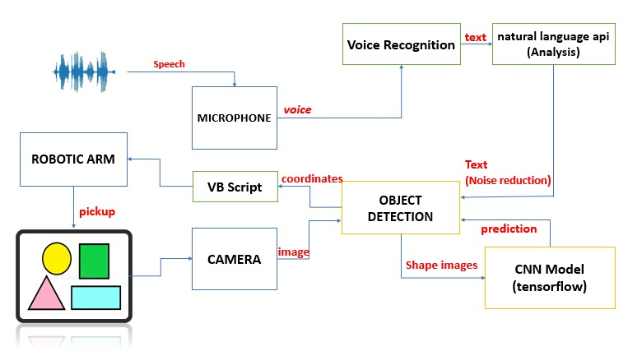
SYSTEM ARCHITECTURE

Slide 7

SHAPE DETECTION
YOLOv5-based Shape Detection: CNN-based YOLOv5 used for shape detection. Used a yolov5 Pretrained model.
Bounding boxes generated around detected shapes.Center point of bounding box extracted for object position.
X and Y coordinates determined from centre point

Slide 8
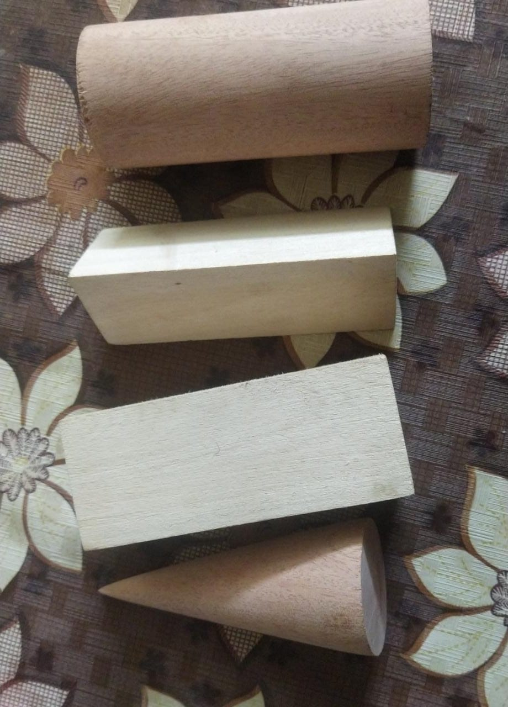

Slide 11
HARDWARE REQUIREMENTS
Webcam: Standard webcam captures real-time video input.
Laptop or Computer: Serves as the processing unit for the system.
SCORBOT-ER 4u Robotic Arm: Used for pick-and-place operations.

Slide 12
HARDWARE REQUIREMENTS
Raspberry Pi 4 Model B+ is used
High-performance 64-bit quad-core processor
Resolutions up to 4K via a pair of micro-HDMI ports
4GB of RAM

Slide 13
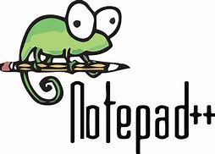

SOFTWARE IMPLEMENTATION
VS Code: Utilized for running machine learning code and developing software components.
SCORBASE: Used to execute SCORBASE commands for controlling the SCORBOT-ER 4u robotic arm.
Notepad++: VB Script, responsible for handling object coordinates, is executed in Notepad++

Slide 14
WORKING DEMONSTRATION

Slide 15
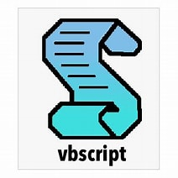
SYSTEM INTEGRATION
Machine learning program is integrated to scorbot using vb script ,vb script passes computed coordinates into scorbase software for execution

Slide 16
PERFORMANCE EVALUATION
USERS | VOICE COMMAND | DETECTED SHAPE | EXPECTED OUTPUT
User 1 | Cylinder | Linder | Cylinder
User 2 | Cylinder | Cylinder | Cylinder
User 3 | Prism | Rism | Prism
User 2 | Cuboid | Cuboid | Cuboid
User 1 | Prism | Prism | Prism
User 4 | Prism | Dhrishyam | Prism
User 5 | Cylinder | Cylind | Cylinder
User 6 | Cuboid | Cuboid | Cuboid
User 7 | Prism | Preesam | Prism
User 5 | Cylinder | Cylinder | Cylinder
User 8 | Prism | Prism | Prism
User 9 | Cylinder | Cylinder | Cylinder
User 10 | Prism | Prism | Prism
Total commands Successful outputs Accuracy of the system |  | 13 8 61.5%

Slide 17
RESULTS AND DESCUSSIONS
The SCORBOT-ER 4u robotic arm successfully performs pick-and-place operations based on the detected shapes, ensuring precise manipulation.
Voice Recognition Accuracy: Achieved an accuracy rate of approximately 65% in voice recognition, enabling effective control of the system through voice commands.

Slide 18
RESULTS AND DESCUSSIONS
The shape detection algorithm demonstrates significant level of accuracy in identifying and classifying various shapes, contributing to reliable object manipulation.
Real-Time Feedback: Real-time feedback ensures prompt and responsive object detection and manipulation, enhancing system performance

Slide 19
CONCLUSION
Our intelligent voice-assisted robotic arm system successfully enables precise object manipulation based on voice commands and shape detection. It enhances efficiency, flexibility, and self-reliance in table-top operations, benefiting various industries and empowering differently-abled individuals. Future possibilities include improving accuracy, expanding shape detection, and exploring new applications.

